Slide 1
Drone Project
By Nicholas Taylor

Slide 2
Teams:
Group 1: Security – Prevent and defend against hacking attempts. These can be done through physical if they obtain access to a drone, through Wi-Fi attacks, RF attacks, GPS attacks, etc. Apply Zero Trust model.
Group 2: Resilience – Prevent and overcome communication interruptions, hardware failures, software failures, etc. Create contingencies, countermeasures, redundancies, etc. Try to eliminate any SPOF (Single Point of Failure) that you can.

Slide 3
Zero Trust Model
The main ideology of the Zero Trust Model is: ​
A small compromise you make in trust can cause; disasters huge financial losses, etc.​
Applying Zero Trust Model:
Treat devices on a network like strangers, they must prove their identity before you can trust them.
If something can be exploited, someone will exploit it.

Slide 4
Eliminating Single Points of Failure
“A 'Single Point of Failure' refers to a vulnerable component in a system that, if it fails, can cause the entire system to fail. ” (sciencedirect.com)
Common strategies of eliminating and reducing points of failure:
Redundancies – If a technology goes down, have another in its place
Contingencies – Have a backup plan
Countermeasures – Actively take measures when needed reduce interruptions
Damage control – If something goes wrong, minimize resulting damages

Slide 5
How to get started:
All Groups:
Read the ICCCN paper
Group 1:
Find vulnerabilities in the current configuration. If something isn’t specified, assume it isn’t implemented.
Group 2:
Look at what could go wrong with the current configuration and think of worst-case scenarios.

Slide 6
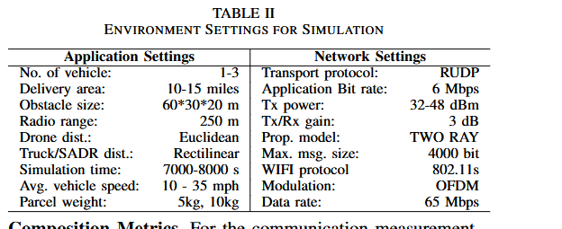
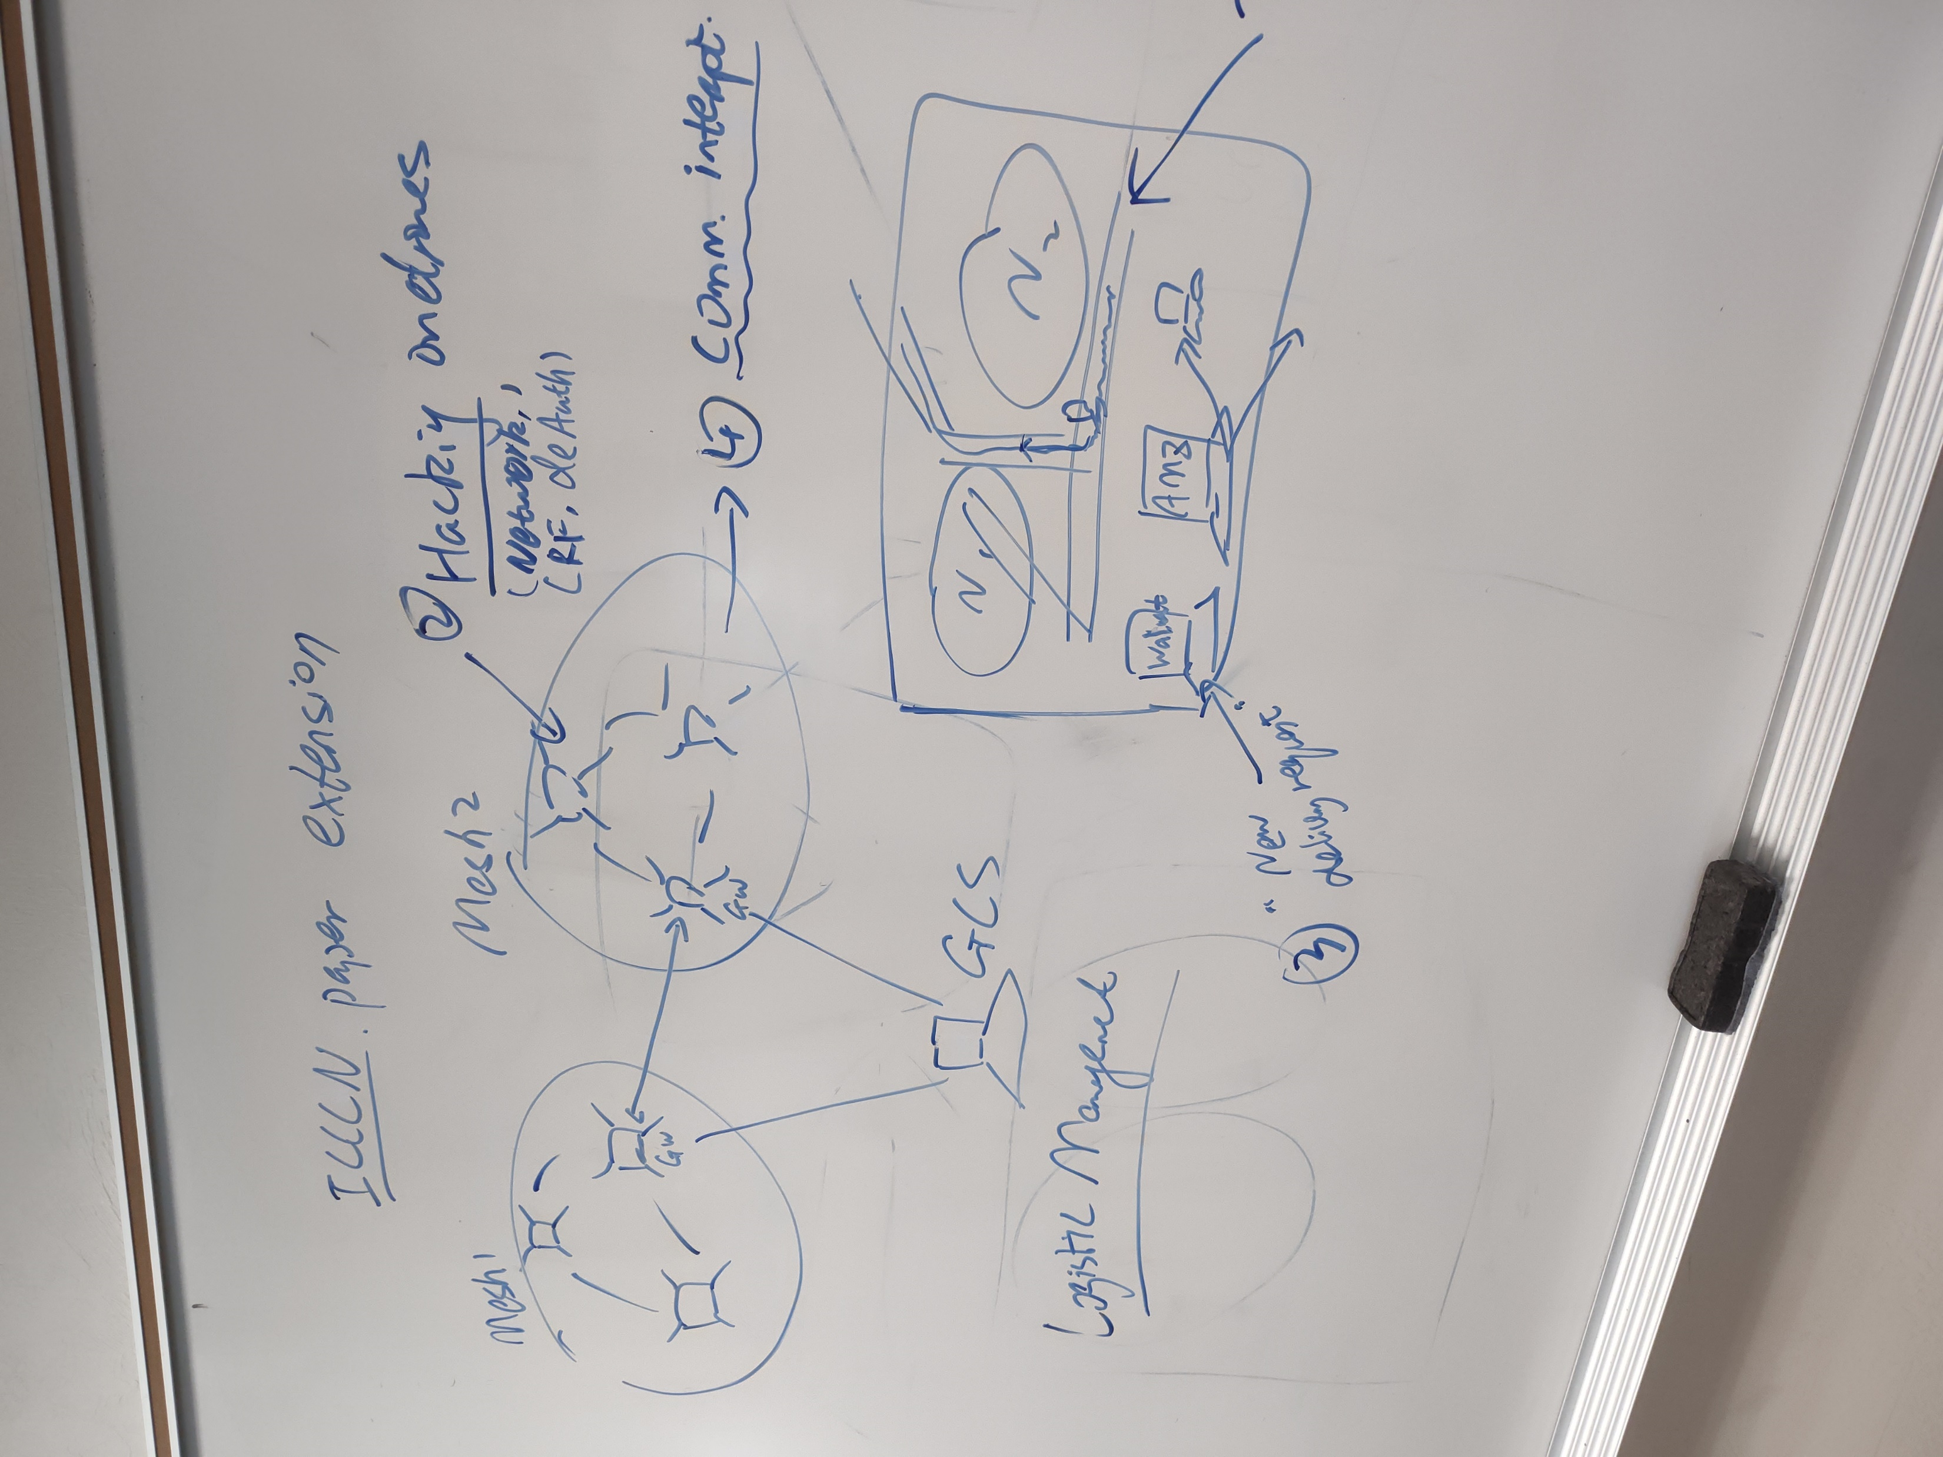
Current configuration
How could this configuration be sabotaged and what could go wrong? How about the sensors on the drone? What could happen during a sabotage?

